Slide 1



Compositional Comparison of Carbonaceous Asteroids from OSIRIS-REx and Oued Chebeika 002 Samples
Cade Smith
Advised By: Dr. Pierre Haenecour
University of Arizona
Arizona Space Grant Symposium
Phoenix, AZ April 19th, 2025

Slide 2
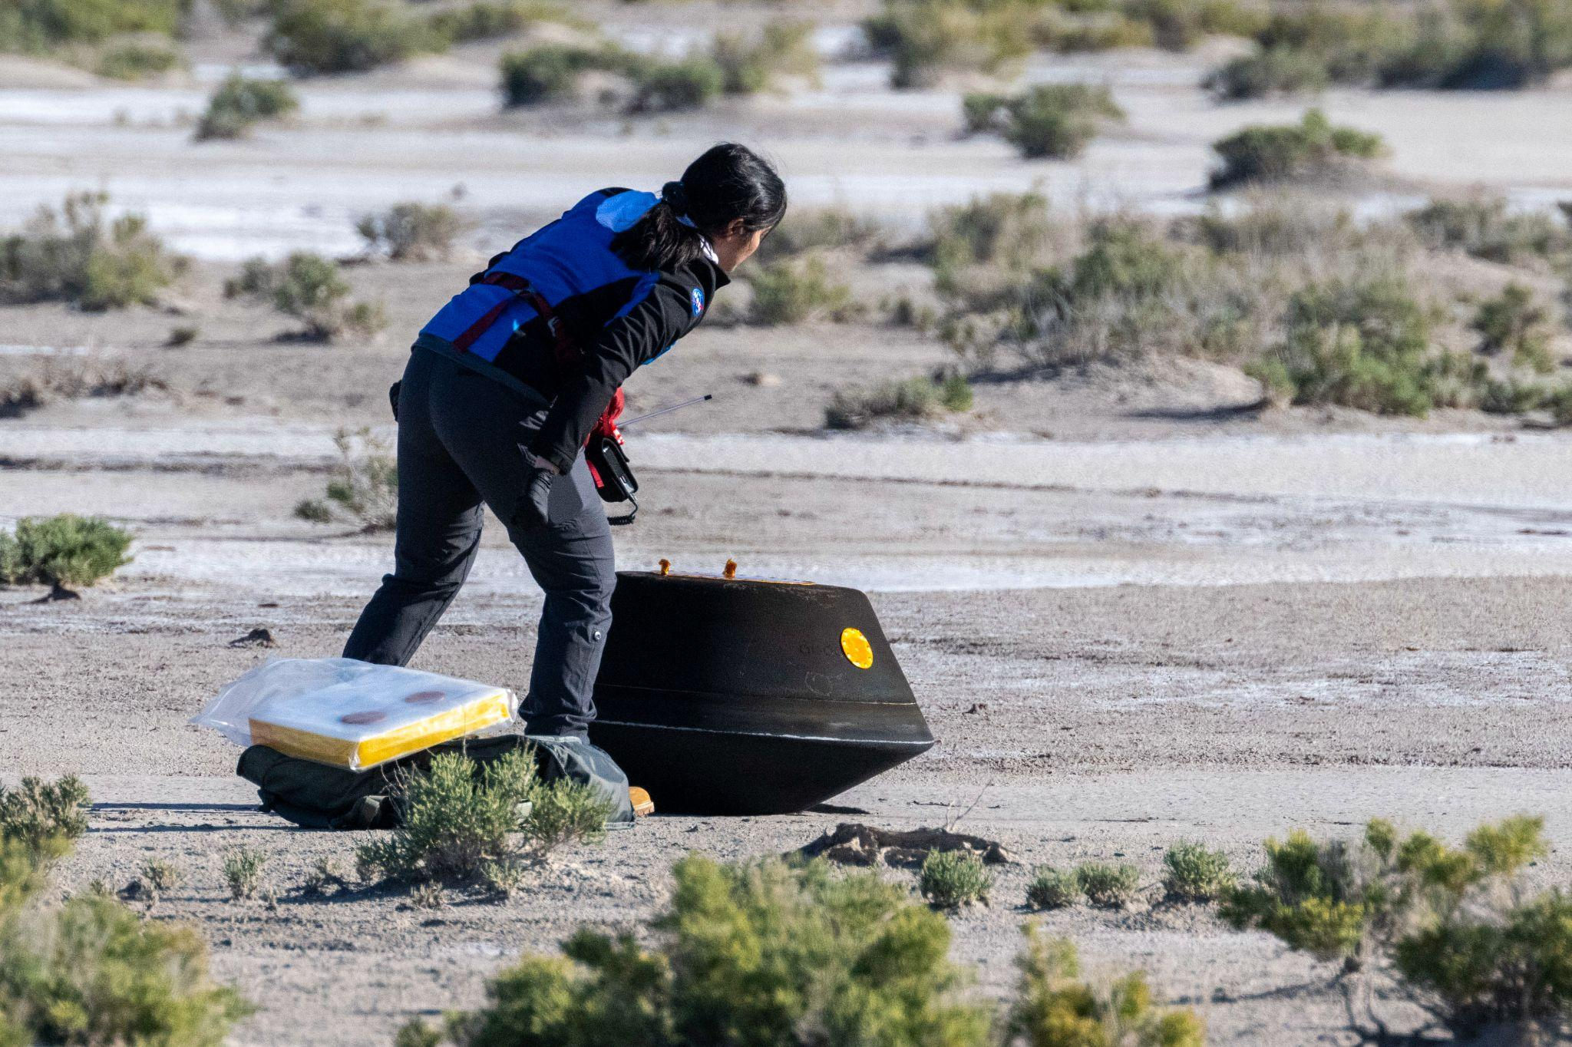
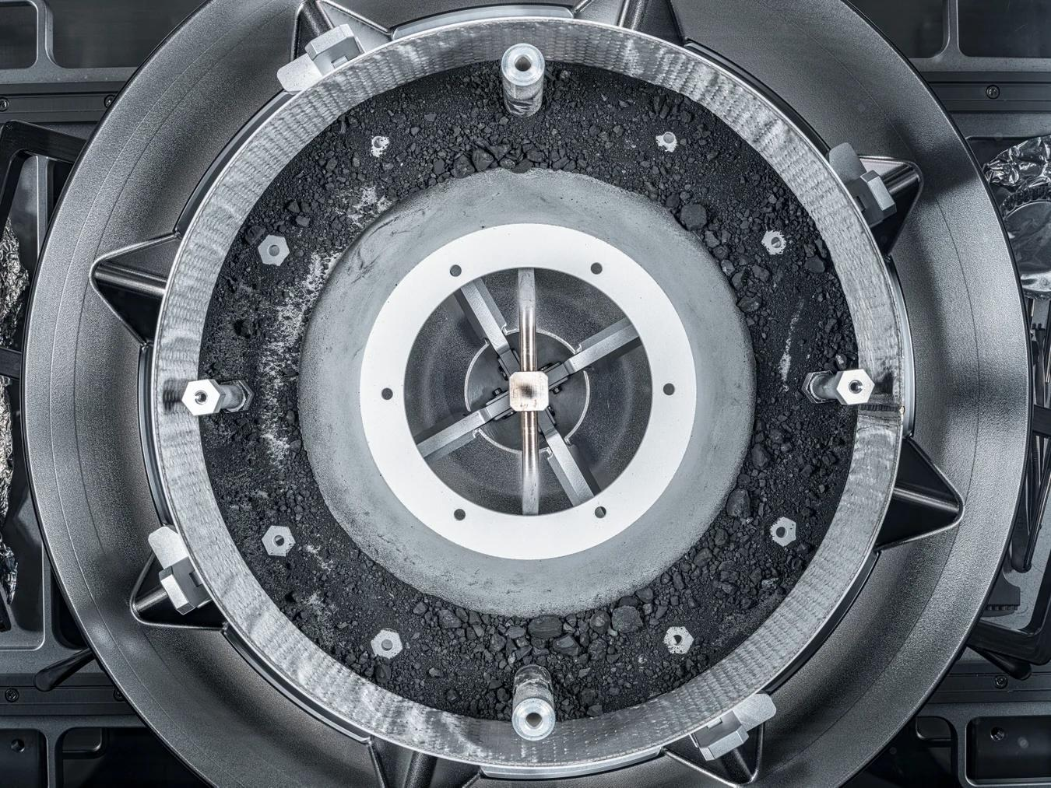
What is the OSIRIS-REx Mission?
NASA sample return mission to
Asteroid Bennu
Interest in learning more about our primordial solar system and the potential origin of life and water on Earth
Samples returned to Earth on September 24, 2023
Credit: NASA OSIRIS-REx Gallery - Sample Return
NASA/Erika Blumenfeld and Joseph Aebersold

Slide 3
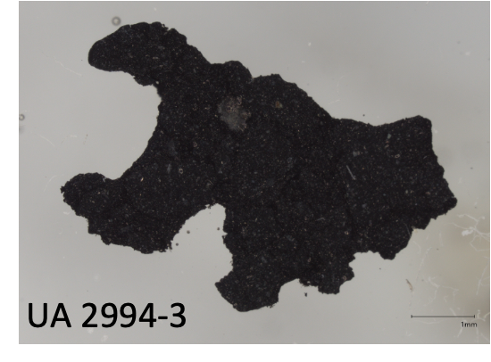
Why Compare to Oued Chebeika 002?
CI chondrite found in Morocco in June 2024
Exhibit close similarities to Bennu samples
Can help us deepen our understanding of
common features of carbonaceous asteroids
Aid in detecting unusual features on Bennu
samples
Oued Chebeika 002 Sample (UA 2994-3) Under Optical Microscope

Slide 4
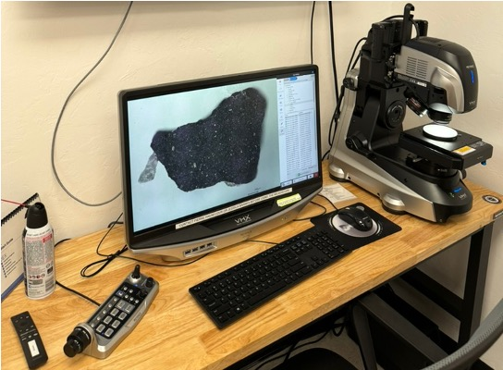
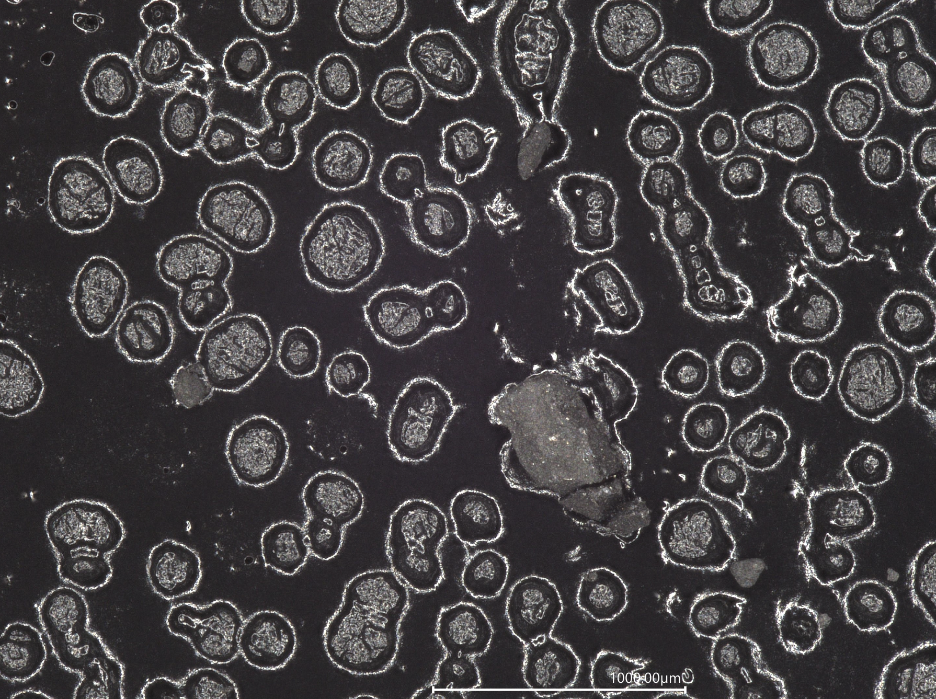
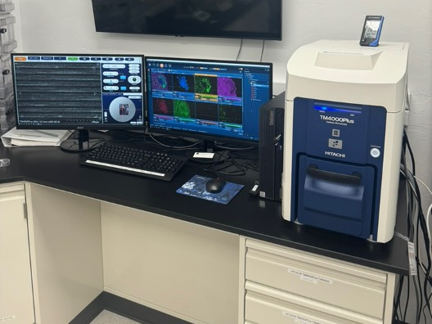
Method and Classifying Minerals
Digital microscopy helps gain a clearer picture of the structure of a sample
Electron microscopy is used to identify elemental abundance, which helps classify minerals
OREx Sample 501083-0 Area 2
under optical microscope
Keyence VHX7000 Digital Microscope (top) and Hitachi TM4000Plus II Tabletop SEM (bottom)

Slide 5
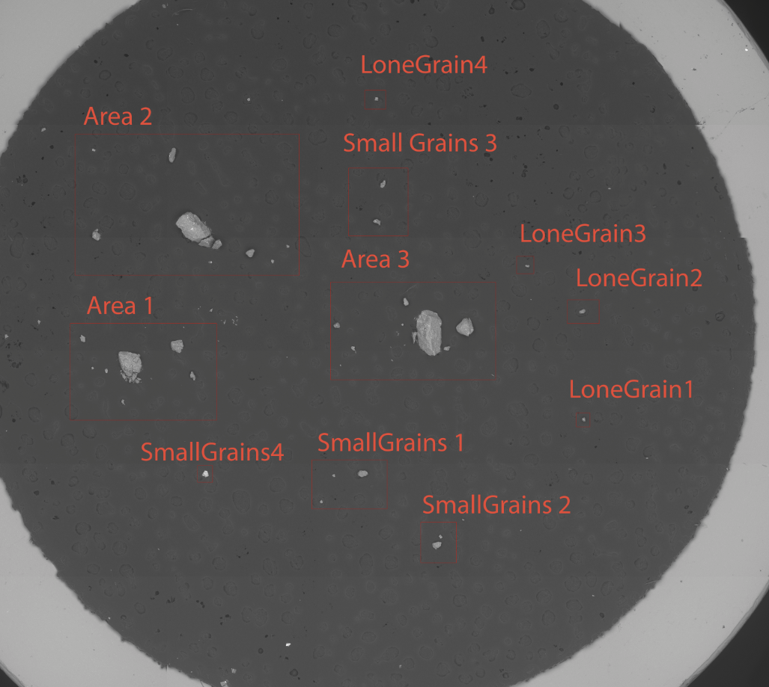
OREx Samples
Data was collected across three samples
OREX-501083-0
OREX-803018-0
OREX-803115-0
Labelled mosaic optical image help keep track of location of minerals
Labelled mosaic image of OREX-501083-0

Slide 6
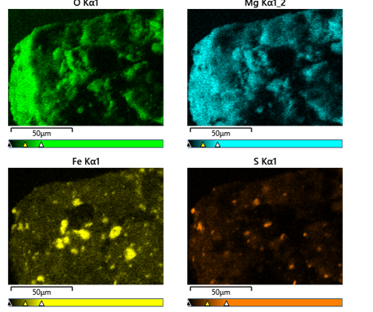
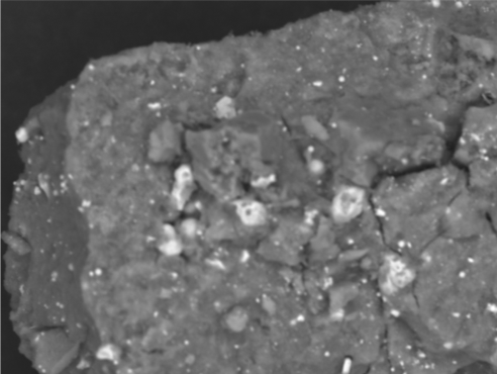
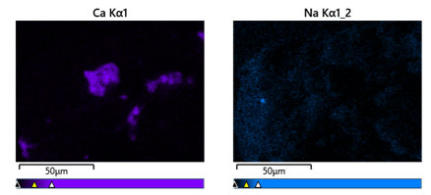
OREx Sample: OREX-501083-0
Area 1 of Sample under Electron Microscope
Elemental Maps of Area 1

Slide 7
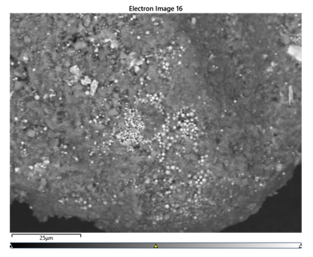
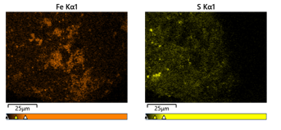
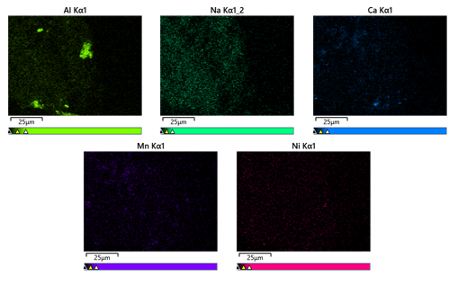
OREx Sample: OREX-501083-0

Slide 8
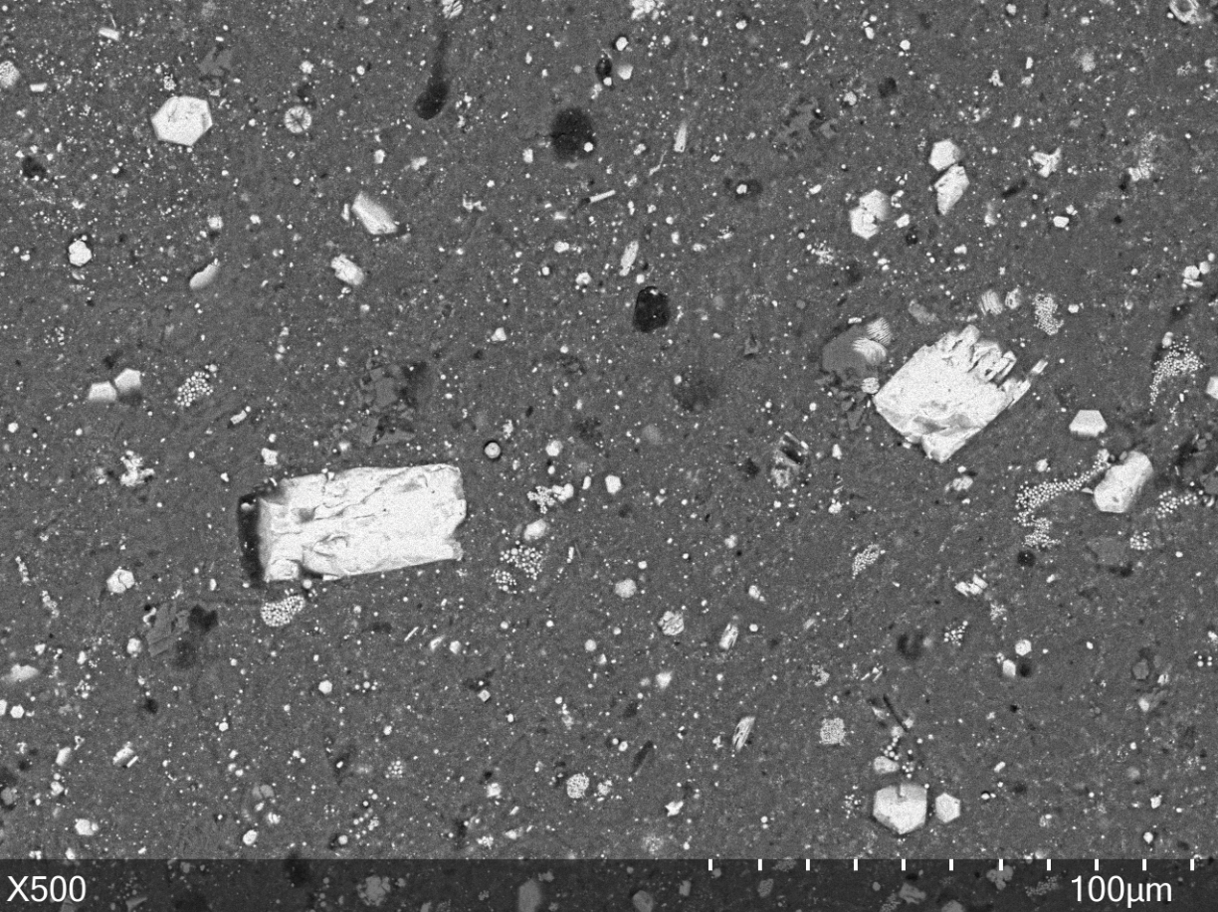
Oued Chebeika Samples
Two Samples:
-UA 2994-8
-UA 2994-3
Same process was conducted for Chebeika as with OREx
Recognizing and classifying distinct features on the sample
Sample Area of Oued Chebeika UA 2994-8 under Electron Microscope

Slide 9
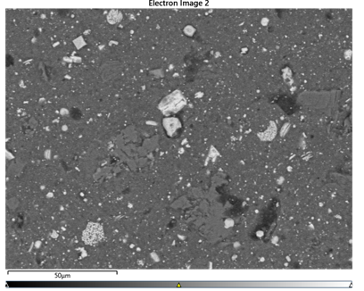
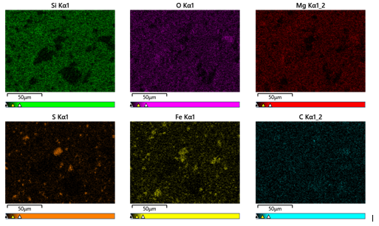
Oued Chebeika Analysis: UA 2994-8
Sample Area 2 of UA 2994-8
Elemental Maps of UA 2994-8

Slide 10
Results and Future Research
Optical and electron microscope observations show that both samples are very similar and mostly composed of fine-grained materials (e.g., clay minerals) mixed together with iron sulfides, iron oxides and C-rich materials
While both samples were rich in iron sulfides/oxides, OREx samples contain higher abundances of Cr-, Ti, or Ni- bearing phases
I’d like to work on further classifying different minerals and look for more unusual features on the OREx samples

Slide 11
Acknowledgment
Pierre Haenecour (Space Grant Advisor and Assistant Professor at LPL)
Lucas Smith (LPL Graduate Student)
Dolores Hill (LPL Lab Safety and Astromaterial Sample Collection Manager)
Michelle Coe and Arizona Space Grant Consortium

Slide 12
Thank You!

